Slide 1
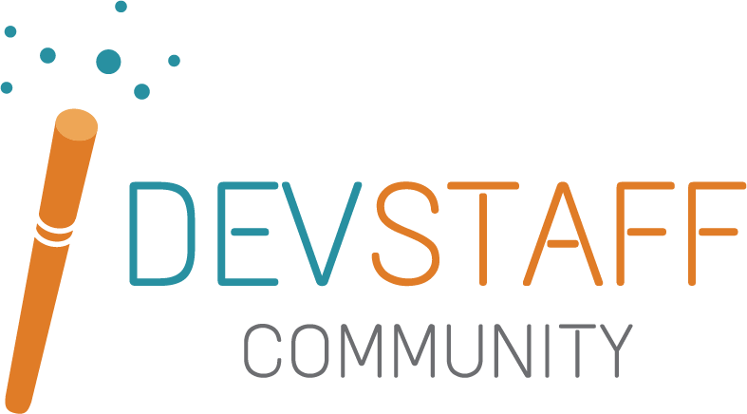
Building Infrastructure as Code: Hands-on Terraform with AWS
May 2023
Georgios Zervakis

Slide 2

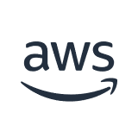



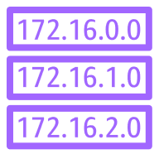

Reference Architecture
VPC
Internet gateway
Public subnet
Dev Instance
Private subnet

Slide 3

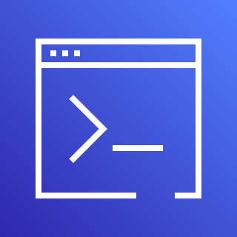

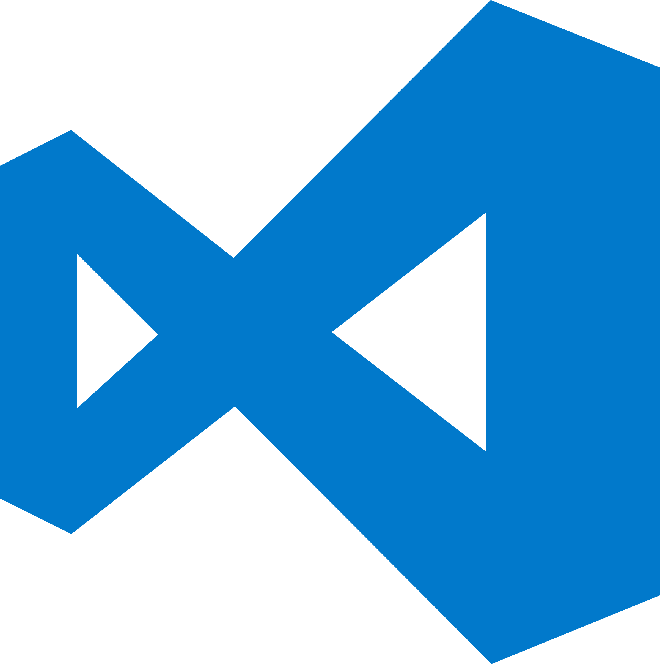
Toolkit

Slide 4
What is in Scope?
In Scope Terraform Best Practises
Out of Scope AWS Best Practises
Folder Structure
Version Control
Remote State
Validation
Variables
Modules
Operational Excellence
Performance Efficiency
Cost Optimization
Sustainability
Reliability
Security
AWS Well-Architected and the Six Pillars
https://aws.amazon.com/architecture/well-architected/

Slide 5
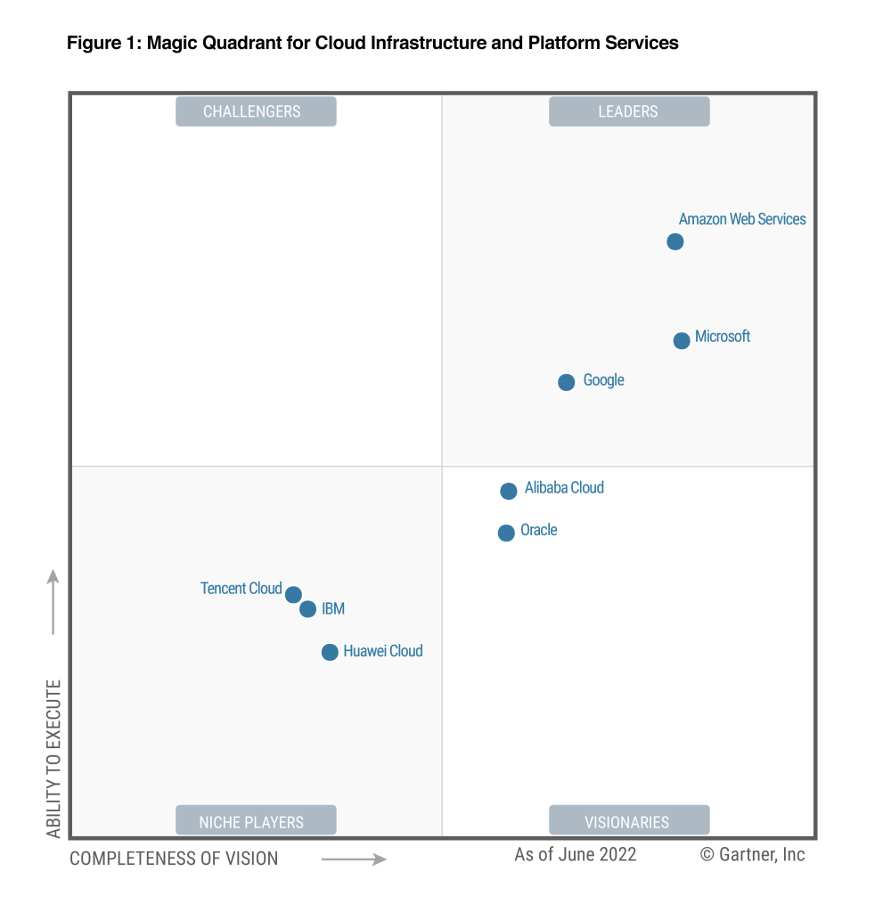
Why AWS?

